Slide 1

Elevating Education: The Online Course Management System

Slide 2



What is an Online Course Management System?
Your Digital Classroom Hub
An Online Course Management System (OCMS) serves as a centralised digital platform, designed specifically to empower educators in the seamless administration of their online classes. It's the virtual equivalent of a well-organised classroom, accessible anytime, anywhere.
Streamlining the Teaching Process
This intuitive tool simplifies a myriad of tasks, from content delivery to student tracking, allowing teachers to focus more on pedagogy and less on administrative burdens. It brings efficiency and structure to the dynamic world of online learning.

Slide 3
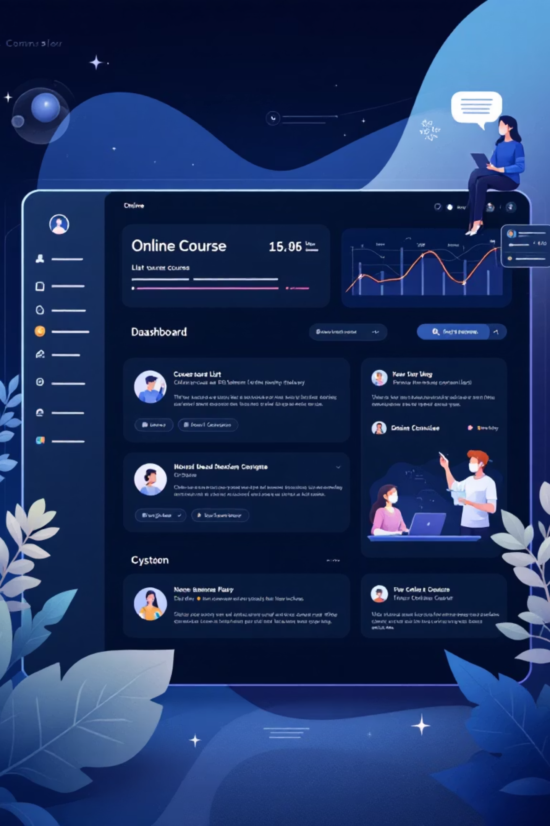




Core Features: Navigating Your Virtual Campus
Intuitive Dashboard
Your personalised command centre, offering a quick overview of active courses, upcoming deadlines, and recent notifications.
Comprehensive Courses
Organise and deliver course materials, lectures, and resources with ease, structured for clear student progression.
Student Management
Effortlessly track student enrolment, progress, and interactions within each course.
Engaging Live Classes
Conduct interactive virtual sessions with built-in tools for real-time collaboration and discussion.

Slide 4

Fostering Connection: Communication Tools
Seamless Messaging
Teachers can directly communicate with individual students or entire classes, providing support and feedback promptly. The system ensures that important messages are delivered efficiently, fostering a supportive learning environment.
Instant Announcements
Broadcast critical updates, reminders, and news to all enrolled students with a single click. This feature is invaluable for keeping everyone informed about course changes, deadlines, or upcoming events.
Effective communication is at the heart of any successful online learning experience, and our OCMS provides the tools to achieve just that.

Slide 5


Evaluating Progress: Assessments & Quizzes
Interactive Quizzes
Design and deploy engaging quizzes to test understanding and reinforce learning. Our system supports various question types for comprehensive evaluation.
Flexible Assignments
Create, distribute, and collect assignments with ease, supporting diverse submission formats. Teachers can provide detailed feedback directly within the platform.
The OCMS streamlines the assessment process, giving teachers clear insights into student comprehension while providing students with timely and constructive feedback.

Slide 6



Designed for Clarity: Simple & Intuitive
Clean Aesthetics
Blue & White Theme
The system boasts a simple, clean, and uncluttered interface, ensuring that both teachers and students can navigate with ease and focus on the content.
Our chosen colour palette of blue and white is not only visually appealing but also promotes a sense of calm and clarity, enhancing the learning experience.
User-Friendly Design
Every element is thoughtfully placed for maximum usability, minimising the learning curve for new users and optimising efficiency for experienced ones.

Slide 7


Getting Started: How it Works for Teachers
01
02
03
Create Your Course
Upload Content
Invite Students
Set up your virtual classroom by adding course details, learning objectives, and initial modules.
Easily add lectures, readings, videos, and other educational resources to each module.
Generate unique enrolment codes or directly invite students to join your course.
04
05
Monitor Progress
Engage & Assess
Utilise the dashboard and analytics to track student engagement and performance.
Communicate with students, conduct live classes, and administer quizzes and assignments.

Slide 8

The Benefits: Empowering Learning & Teaching
For Teachers
Our OCMS dramatically reduces administrative workload, allowing educators to dedicate more time to teaching and fostering deeper student engagement. It provides powerful tools for content delivery, assessment, and progress tracking, all within an intuitive interface.
1
For Students
Students benefit from a clear, organised, and accessible learning environment. They can easily access course materials, submit assignments, participate in discussions, and track their own progress, promoting independent learning and improved outcomes.
2

Slide 9

Transforming Online Education
The Online Course Management System is more than just a tool; it's a partner in creating effective, engaging, and accessible online learning experiences for everyone. Embrace the future of education with a platform built for success.

